Slide 1

Wind Turbine Project
Group – 1(B)
Roll :2113004,2113006
Department of Energy Science and Engineering
Khulna University of Engineering & Technology
Khulna-9203, Bangladesh

Slide 2
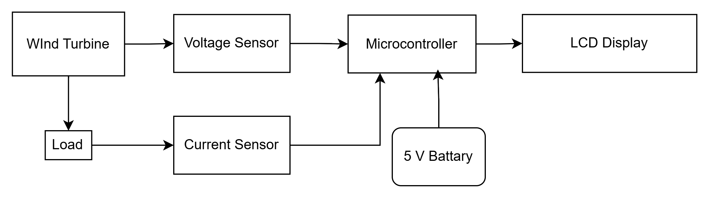
Block Diagram of Wind Turbine Project

Slide 3
Component List
Turbine blade
12V DC Motor
Arduino Uno
I2C LED Display
Battery (5V)
Voltage sensor ( 0-24) V
INA219 current sensor( 1mA - 3A)
Angle
screw
Particle Board (1 x 1.5) sq feet
Dotted Vero-board
Female header pin
Connecting wire
Soldering lead
Connector

Slide 4
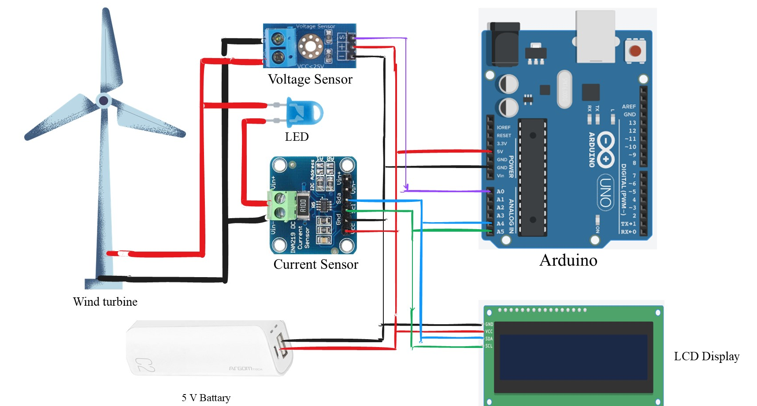
Circuit Diagram of Wind Turbine Project

Slide 5
Wind Speed | Voltage | Current | Power
2.45 | 0.19 | 0.16 | 0.03
3.58 | 0.17 | 0.16 | 0.02
4.24 | 1.3 | 0.17 | 0.24
5.09 | 2.08 | 27.68 | 57.7
5.63 | 2.66 | 78.79 | 210.23
6.19 | 3.15 | 124.45 | 392.89
7.07 | 3.18 | 144.68 | 460.67

Slide 6
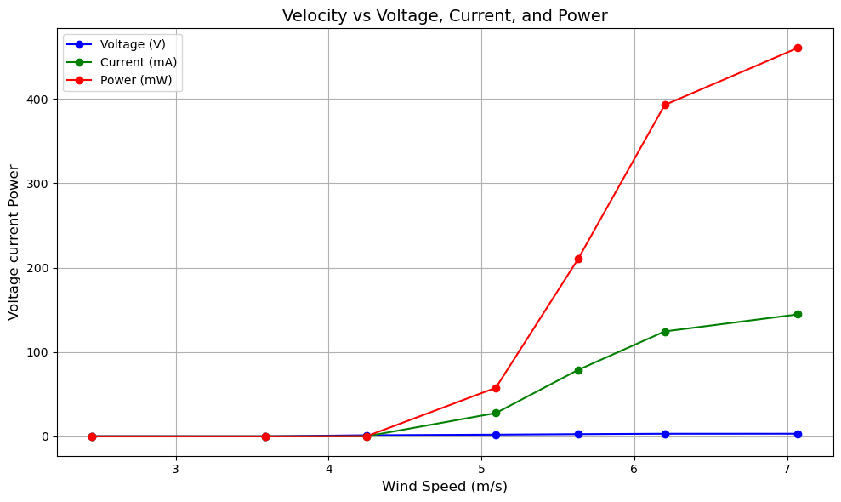

Slide 7
